Slide 1



Project 4

Slide 2
Introduction to Project 4
The Advanced Diploma aims to provide you with an advanced understanding of application development, communication networks and multimedia applications and to apply the critical competencies and skills in this specialised field.
The Advanced Diploma in Information Technology is designed to produce a graduate with the requisite specialist theoretical and practical skills in the latest technologies and tools employed within the field. This program will deepen your knowledge and develop your applied competence in analysing, interpreting, understanding and applying communication networks, multimedia and application development technologies and tools.

Slide 3
Introduction to Project 4 (Cont.)
It further develops your intellectual independence, research and professional skills. A rapidly changing technological and digital landscape demands practitioners and experts who can understand, respond to, and further the aims of the industries you serve.
It also requires graduates who can research, reflect, innovate, problem-solve and integrate knowledge in a discipline-specific way while serving general or specific societal needs.
The Advanced Diploma in Information Technology is built on the foundations laid by the Diploma in ICT. It aims to advance applied and general skills and to offer a degree of specialisation in the field of general Applications Development, Multimedia, or Communication Networks. This specialisation is one of the core disciplines in ICT.

Slide 4
Student Engagement with the content

Slide 5

So What does this mean
40 credits – 400 hours for the year
120 contact hours
Contact time = 7 periods per week over 22 weeks
What about 280 hrs left
Which equates to 13 hours per week over 22 weeks

Slide 6
Weekly contact time
40 credits – 400 hours for the year
120 contact hours
Contact time = 7 periods per week over 22 weeks
We are supposed to meet for 5 hours and 15 minutes a week.
What about 280 hrs left
Which equates to 13 hours per week over 22 weeks
This means the time allocated for Projects is:
5 hours and 15 minutes + 13 Hours = 18 hours and 15 minutes.

Slide 7
Supervisors
You will be allocated a supervisor next week.
Full-time students will meet during the week, probably when the supervisor can meet you as a student.
You have to meet on a weekly basis, as there are deadlines to meet.
Ethics clearance must be done by the end of the term (no later submissions will be accepted – you will have to cancel the subject)
Marking is done by other supervisors…

Slide 8
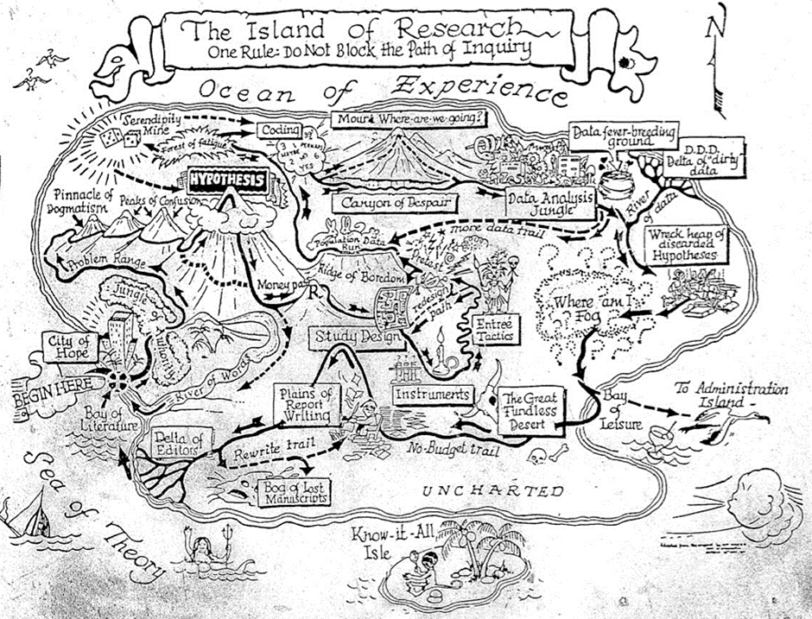

Slide 9
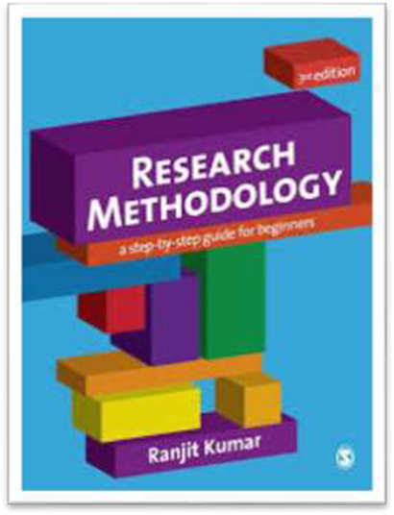




Learning Resources
MAIN TEXTBOOK
(Kumar, R 2011)
SUPPLEMENTARY TEXTBOOKS
Booth et al, 2016
Terre Blanche et al, 2006
Blaxter et al, 2006
Maree, 2016

Slide 10
Why do we write it up
We write to:
Remember
Understand
Test our thinking
For a reader
Final submission is a formal report
We are not allowed to put copies of textbooks on BlackBoard.

Slide 11
A Scientific Attitude
Search for the facts using a scientific method
The quality of the data (is very important
Become a critical thinker

Slide 12
Scientific Knowledge is only concerned with
… what are the facts
… evidence is very important
… how did you get to your solution
… the research process is therefore very important

Slide 13
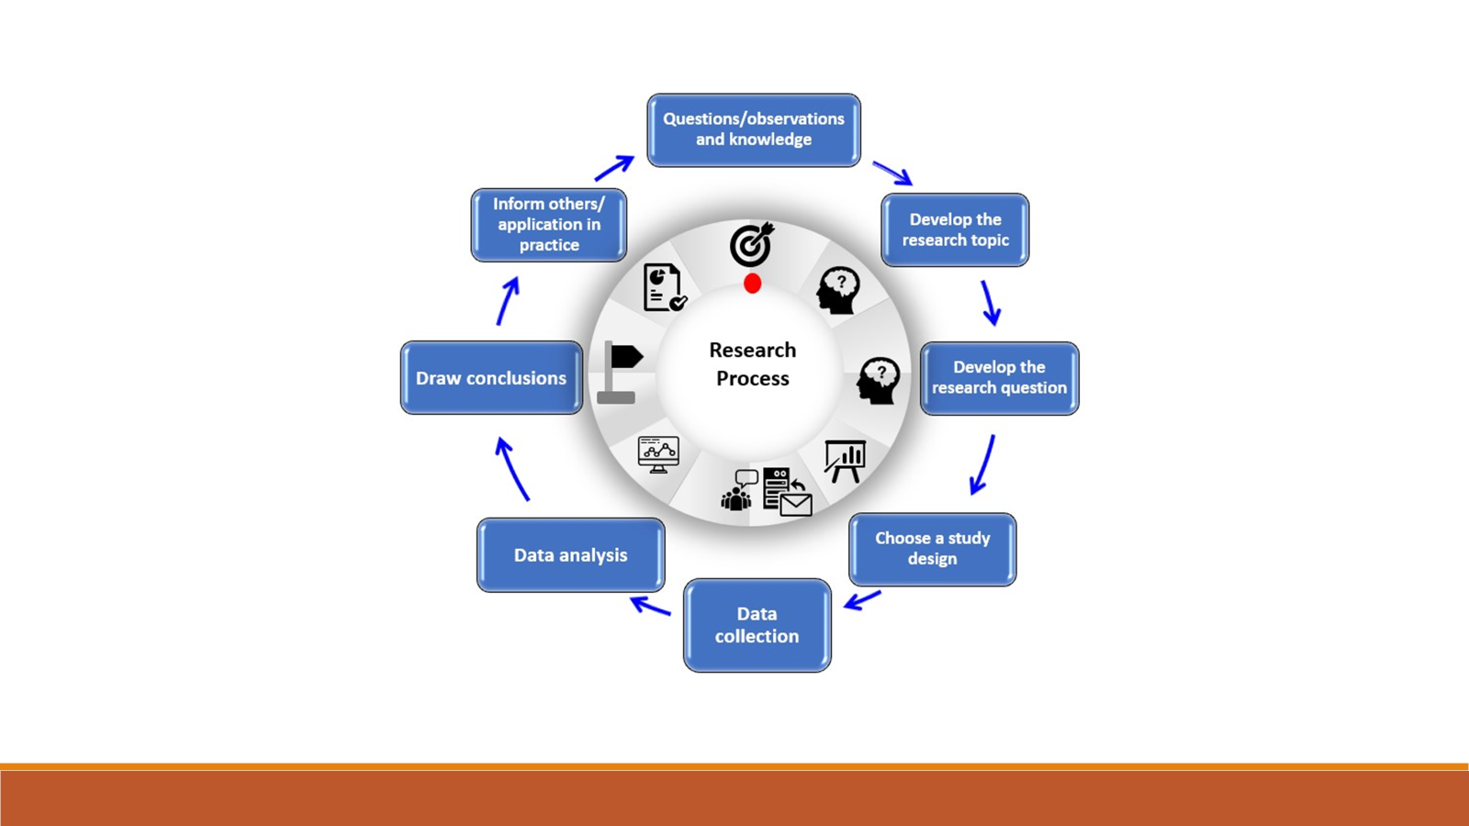

Slide 14
All Research
Data will be in the form of Documents/articles
No interviews
No questionnaires
I will allocate supervisors
Full-time students will have supervisors during the day

Slide 15

Week 1 Homework
Start the process of reading on your topic of interest
Look for 10 articles that relate to the topic of your research
5 South African and 5 international articles

Slide 16


Next week: Selecting a Topic

